Slide 1

Exploring High-Capacity Storage Options for Medical IMU Data: A Zephyr-Based Approach
Master Project Mid-Term Presentation
Denis Buckingham
Dr. Paulius Viskaitis
Dr. Dane Donegan
Prof. Dr. Roger Gassert
Prof. Dr. Janos Vörös
denisb@student.ethz.ch
ETH Zurich, Switzerland | 15. May 2024
Notes:
https://ethz.zoom.us/s/65787172490

Slide 2
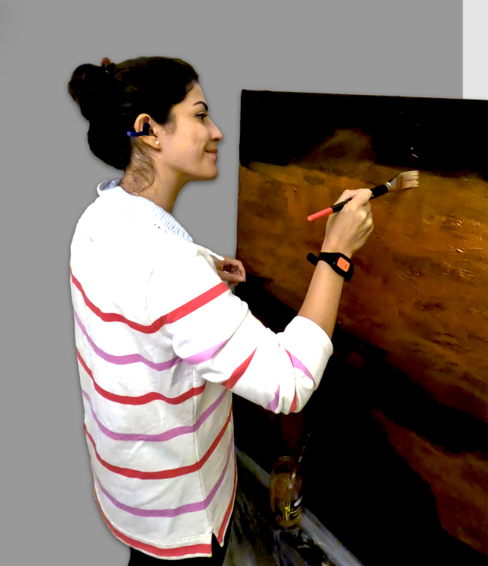

Exploring High-Capacity Storage Options for Medical IMU Data: A Zephyr-Based Approach
Master Project Mid-Term Presentation
Denis Buckingham
Dr. Paulius Viskaitis
Dr. Dane Donegan
Prof. Dr. Roger Gassert
Prof. Dr. Janos Vörös
denisb@student.ethz.ch
ETH Zurich, Switzerland | 15. May 2024
Notes:
https://ethz.zoom.us/s/65787172490

Slide 3
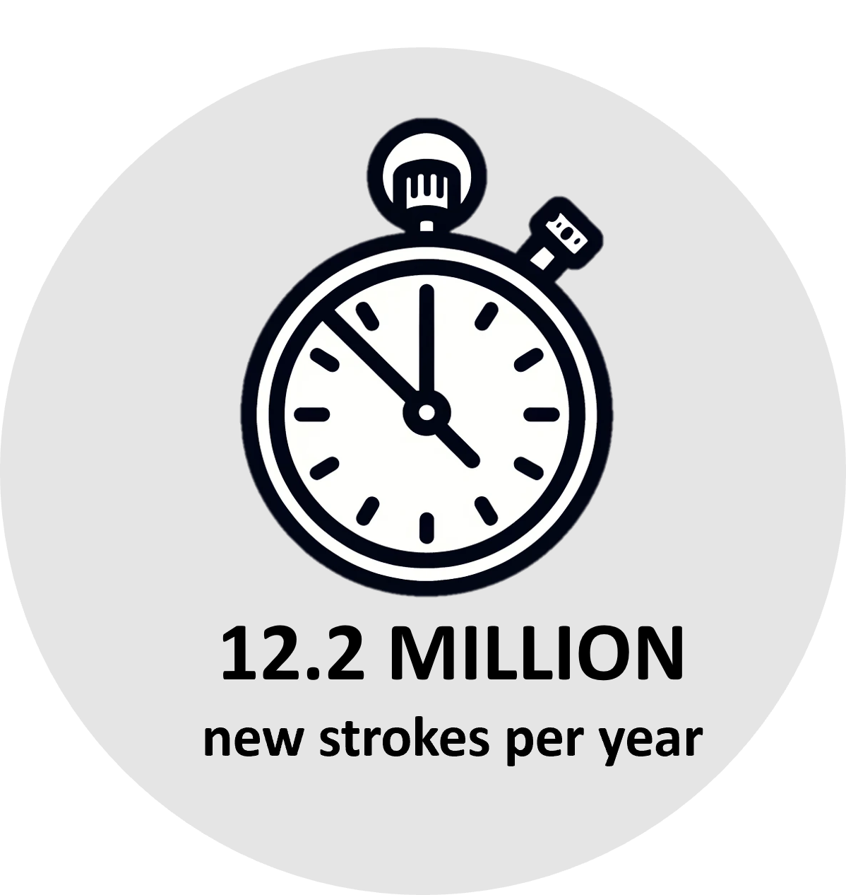
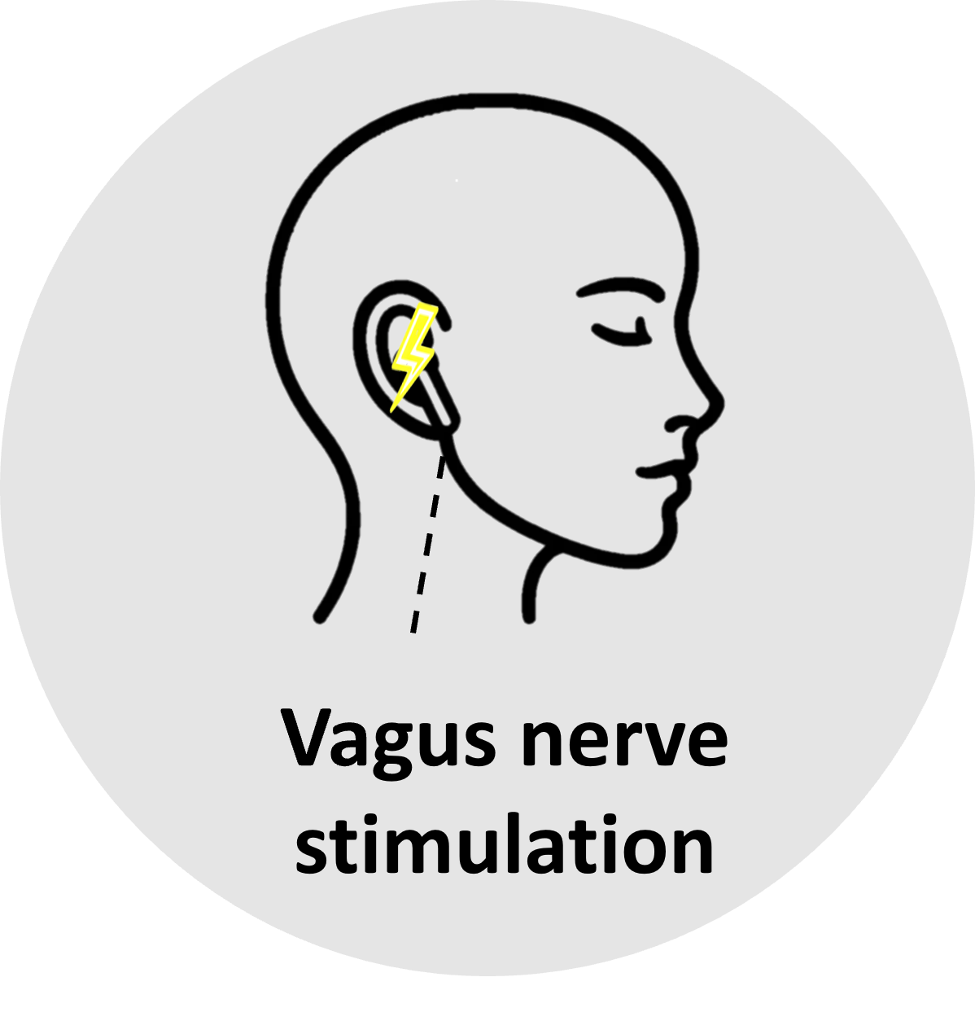
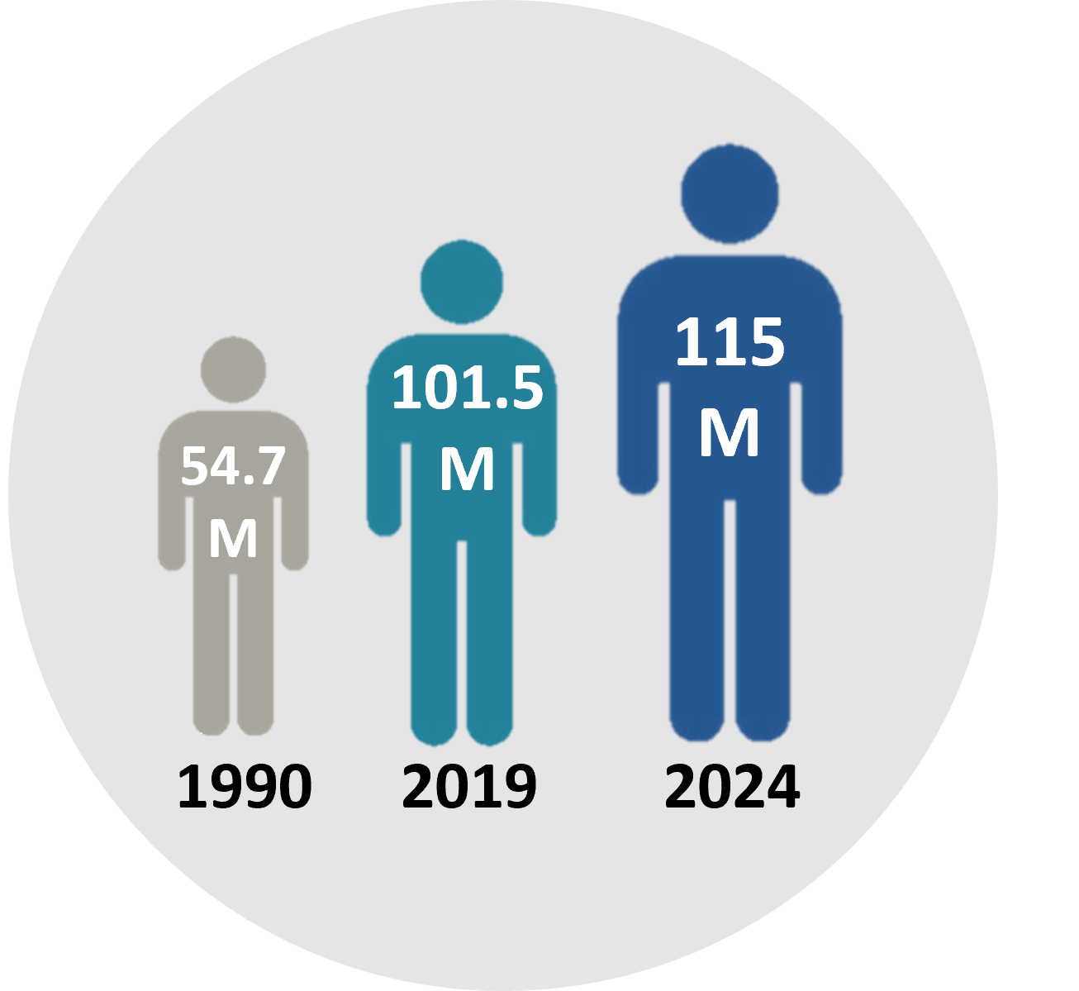
Why aVSN?
[1]
[1], [2]
Methods
Discussion
Conclusion
Intro
Background
Results

Slide 4
Why aVSN?
[1]
[1], [2]
Methods
Discussion
Conclusion
Intro
Background
Results

Slide 5
Why aVSN?
[1]
[1], [2]
Methods
Discussion
Conclusion
Intro
Background
Results

Slide 6
Why aVSN?
[1]
[1], [2]
Methods
Discussion
Conclusion
Intro
Background
Results

Slide 7






Why aVSN?
12.2 MILLION new strokes per year
115 M
101.5 M
54.7 M
[1]
Vagus nerve stimulation
1990
2019
2024
[1], [2]
Methods
Discussion
Conclusion
Intro
Background
Results

Slide 8

Introduction – SmartVNS
Our design constraints:
Low power consumption
Reliable
High storage capacity
Small size
Methods
Discussion
Conclusion
Intro
Background
Results

Slide 9

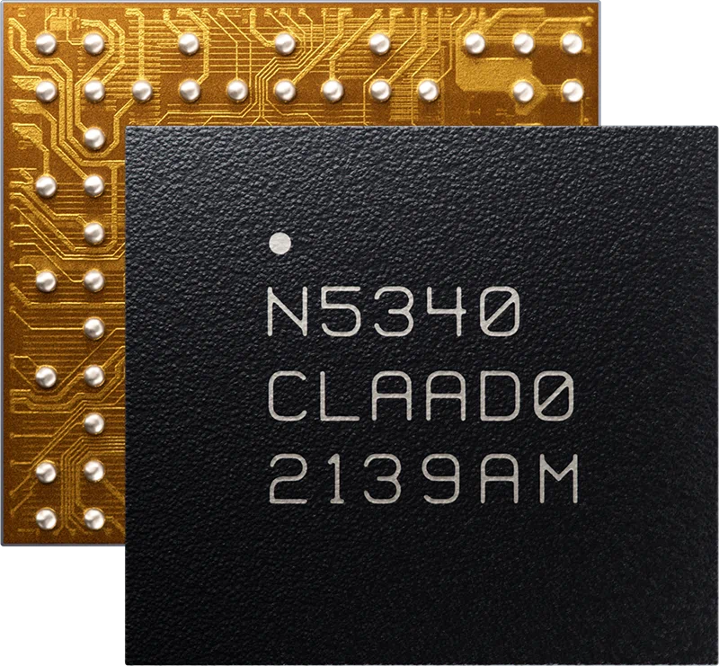

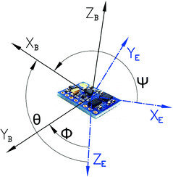
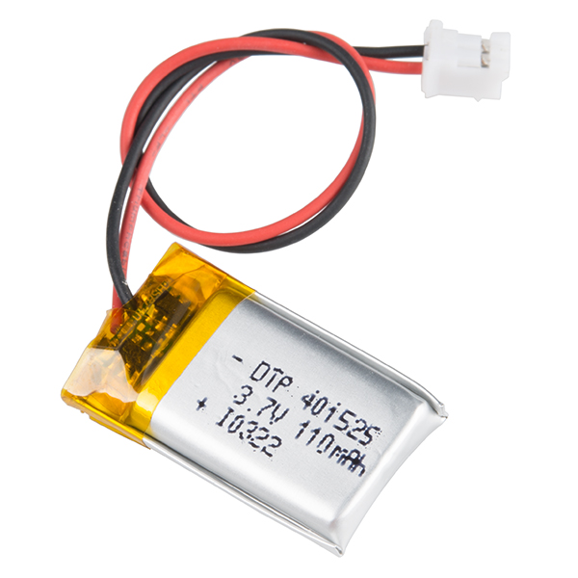
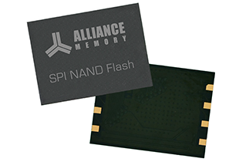





Motion Tracker Overview
CPU
SPI/I2C
SPI
Battery
Inertial Measurement Unit (IMU)
Storage
Methods
Discussion
Conclusion
Intro
Background
Results

Slide 10
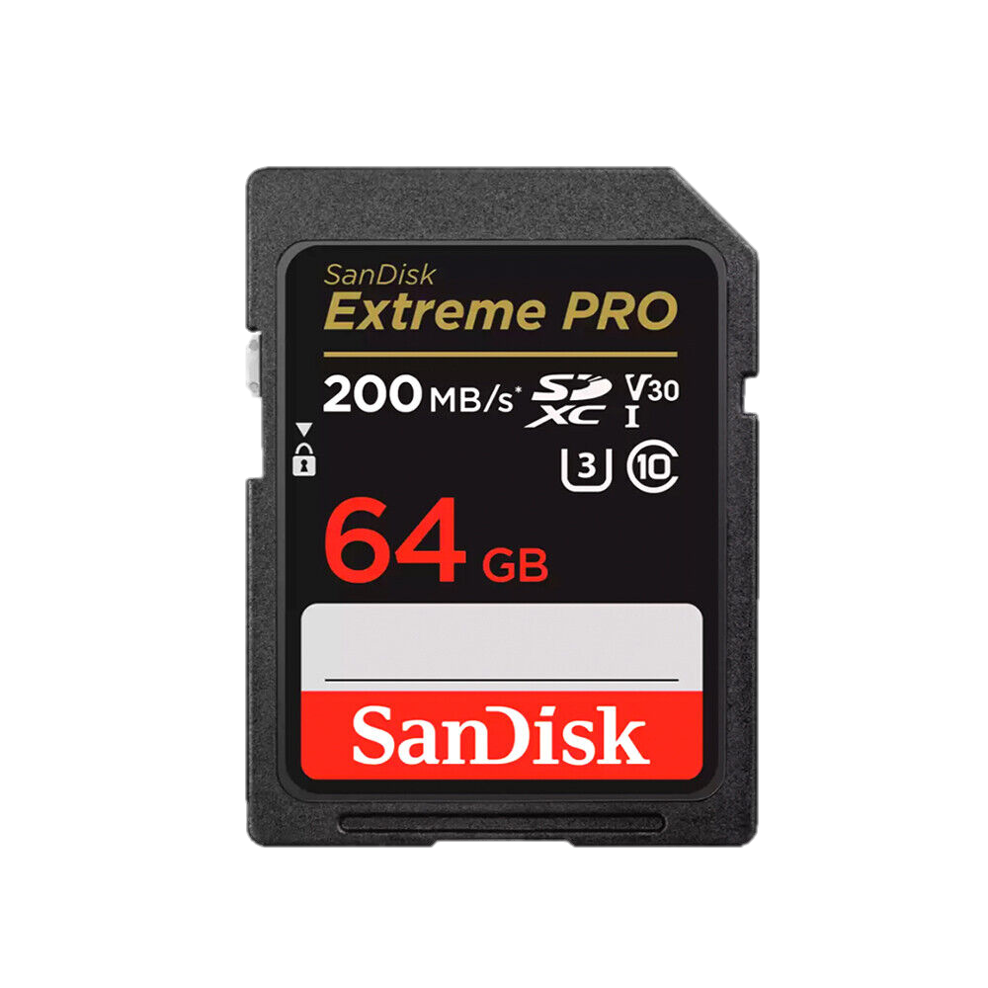
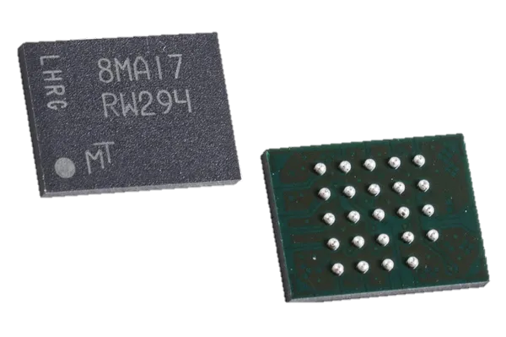



Storage Devices
SD Card
SPI
NOR Flash
CPU
NAND Flash
Methods
Discussion
Conclusion
Intro
Background
Results

Slide 11
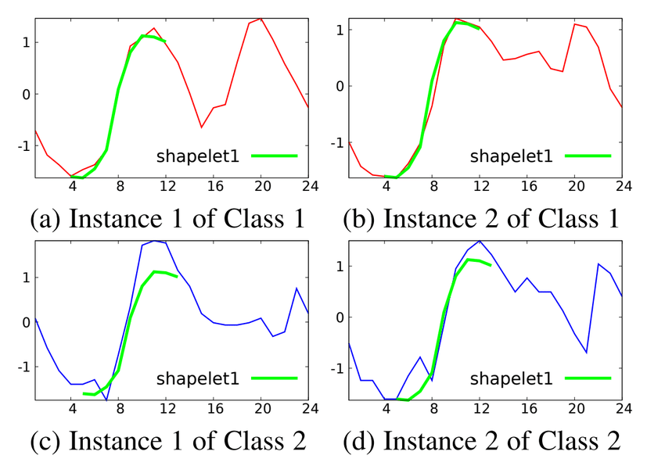
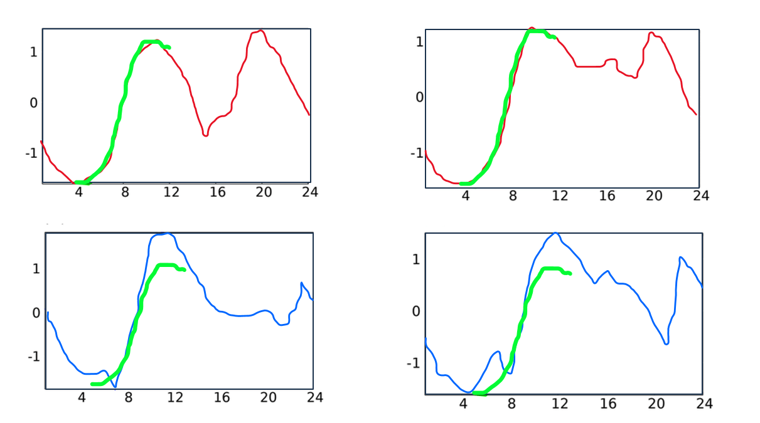
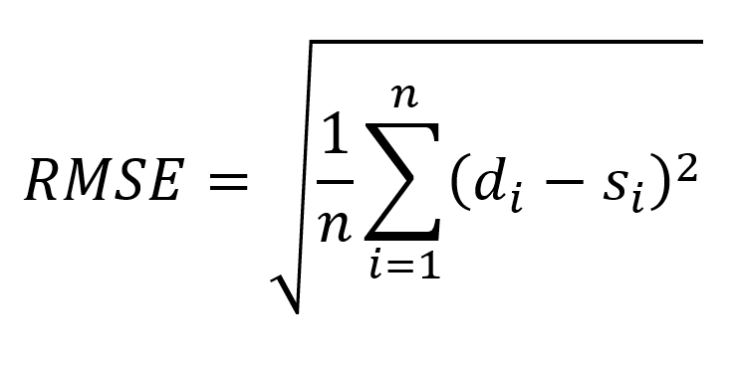
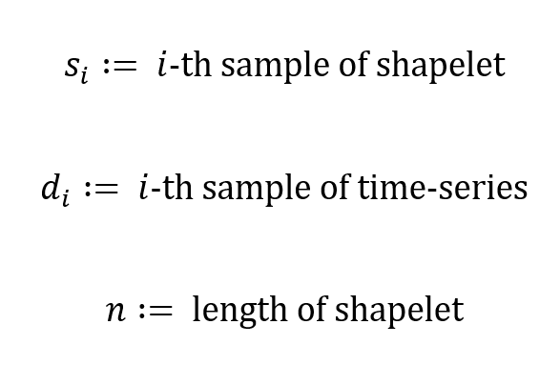
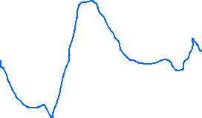


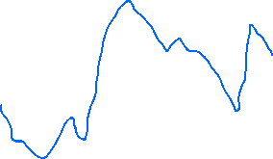

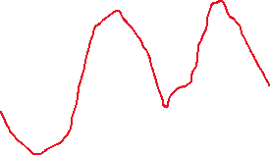

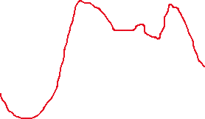
Shapelet Classifier
“Shapelets are discriminative sub-sequences of time series that best predict the target variable”
1. Introduction
[15]
Instance 1
Instance 2
Comparison Metric
2. Previous Work
3. Methods
Class 1
4. Results
5. Discussion
Class 2
6. Future Directions
[16]
Methods
Discussion
Conclusion
Intro
Background
Results

Slide 12
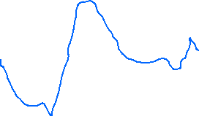

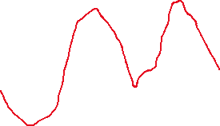

Shapelet Classifier
“Shapelets are discriminative sub-sequences of time series that best predict the target variable”
1. Introduction
[15]
Instance 1
Instance 2
Comparison Metric
2. Previous Work
3. Methods
Class 1
4. Results
5. Discussion
Class 2
6. Future Directions
[16]
Methods
Discussion
Conclusion
Intro
Background
Results

Slide 13

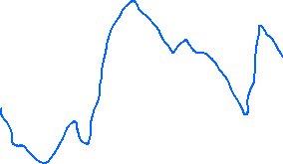

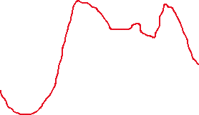
Shapelet Classifier
“Shapelets are discriminative sub-sequences of time series that best predict the target variable”
1. Introduction
Li et al., 2020
Grabocka et al., 2014
Instance 2
Instance 1
MAIN GOALS
Comparison Metric
2. Previous Work
IMPROVE EXISTING CLASSIFICATION ALGORITHM IN
IMPROVE EXISTING CLASSIFICATION ALGORITHM IN
3. Methods
Class 1
- Accuracy
4. Results
- Real-time performance
- Explainability
5. Discussion
Class 2
6. Future Directions

Slide 14
Shapelet Classifier
- Accuracy
- Real-time performance
- Explainability
1. Introduction
Grabocka et al., 2014
Pipeline
2. Previous Work
Preprocessing
Approaches
Fine-Tuning
3. Methods
Class 1
1: Searching Shapelets
- Datastream Selection
Grid Search:
State-Machine
4. Results
2: Learning Shapelets
- Filtering
3: Targeted Logistic Regression
5. Discussion
Class 2
Accuracy
Accuracy
6. Future Directions
1
2
3
RT-performance
Explainability

Slide 15
Timeline
4th of March
1. Introduction
Literature/Code Review
2. Previous Work
Preprocessing
3. Methods
Class 1
Approaches
4. Results
5. Discussion
Fine Tuning
Class 2
6. Future Directions
Report
10th of June

Slide 16
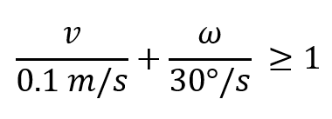
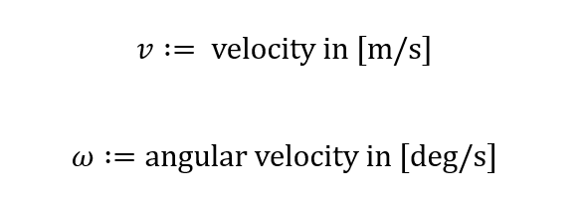
Data Acquisition and Labeling
1. Introduction
Data Acquisition
- single wrist-worn IMU
2. Previous Work
- ground-truth data with VICON
3. Methods
Class 1
Labeling
4. Results
- “movement” if:
5. Discussion
- “movement event” if:
Class 2
6. Future Directions
Definition (I) holds for 0.5 s continuously
at least 5cm travelled and/or 30° accrued

Slide 17
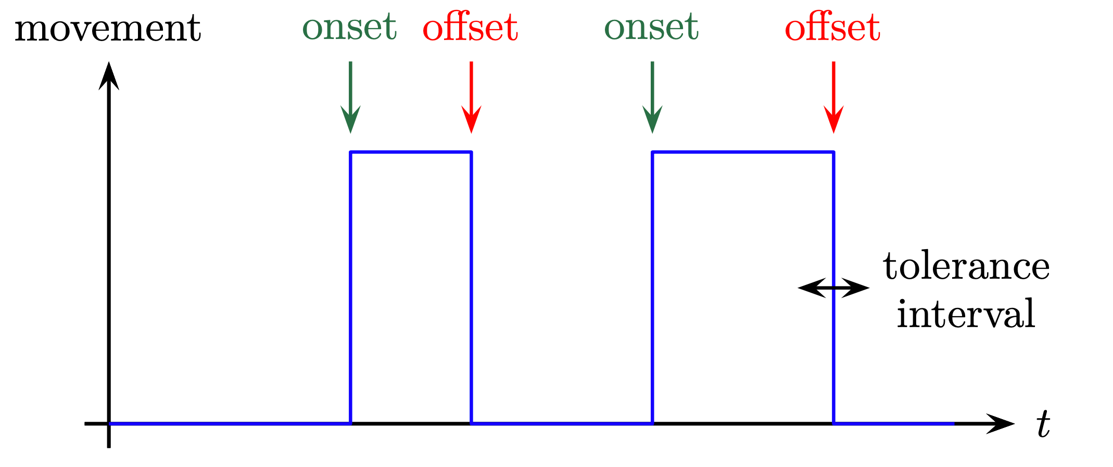
Evaluation
Event-based Assessment
1. Introduction
2. Previous Work
Movement
Ground Truth
3. Methods
Prediction
4. Results
5. Discussion
Rest
6. Future Directions
Flicker
t
-80 ms
+300 ms

Slide 18
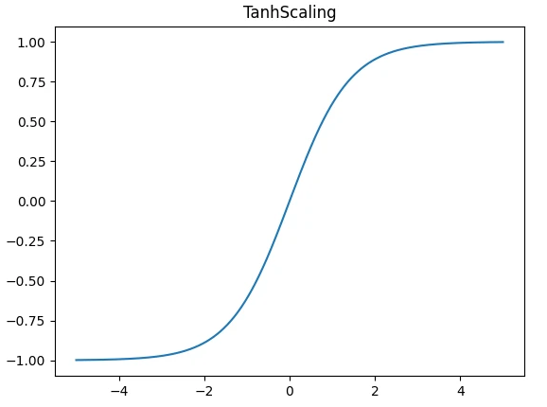
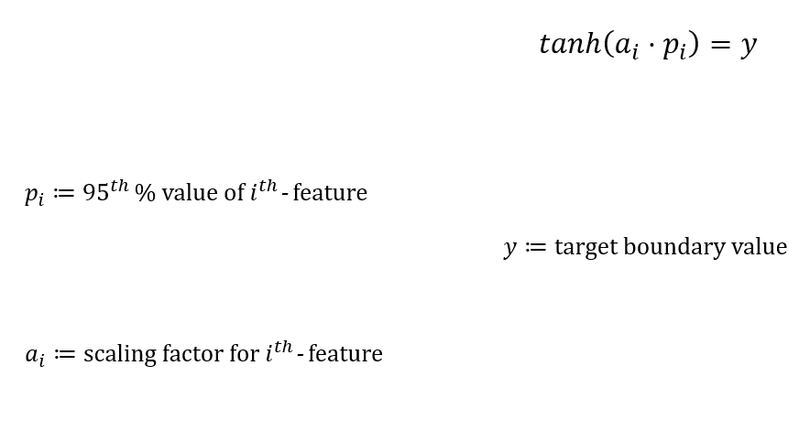
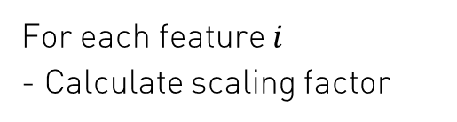
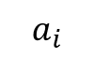
Preprocessing
Tanh-Scaling
1. Introduction
For each feature $i$
- Calculate scaling factor
2. Previous Work
$$a_{i}$$
3. Methods
4. Results
5. Discussion
6. Future Directions

Slide 19
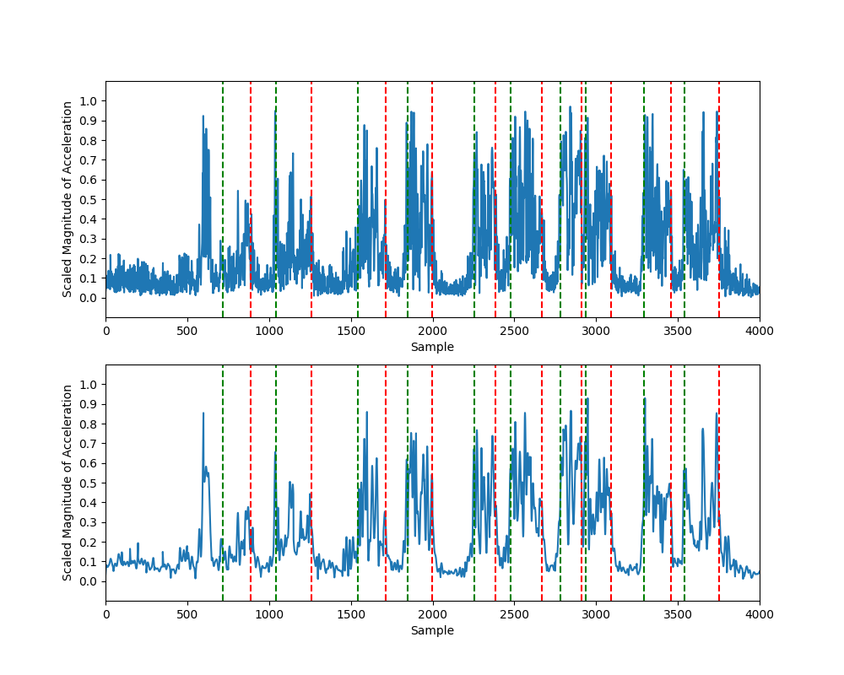
Preprocessing
Filtering
1. Introduction
Raw Acceleration
2. Previous Work
3. Methods
4. Results
5. Discussion
6. Future Directions

Slide 20
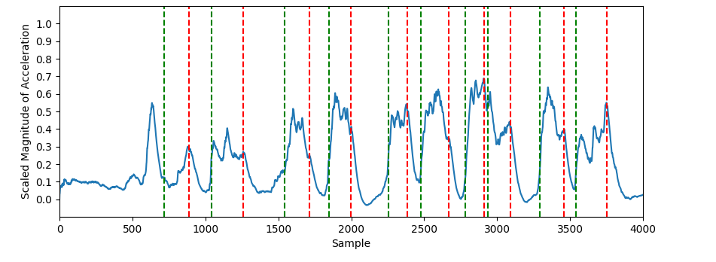
Preprocessing
Filtering
1. Introduction
2. Previous Work
Raw Acceleration
3. Methods
4. Results
5. Discussion
Butterworth Filter
6. Future Directions
Kalman Filter

Slide 21
Preprocessing
Raw Acceleration
Filtering
1. Introduction
Butterworth Filter
2. Previous Work
3. Methods
4. Results
Kalman Filter
5. Discussion
6. Future Directions

Slide 22
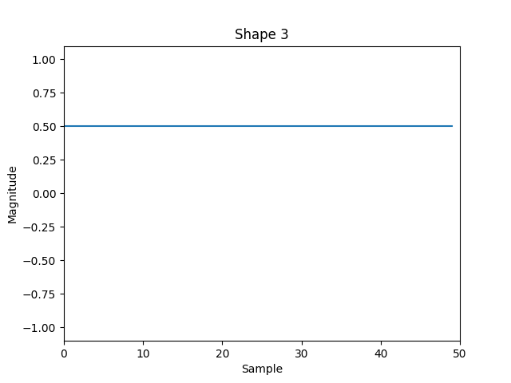
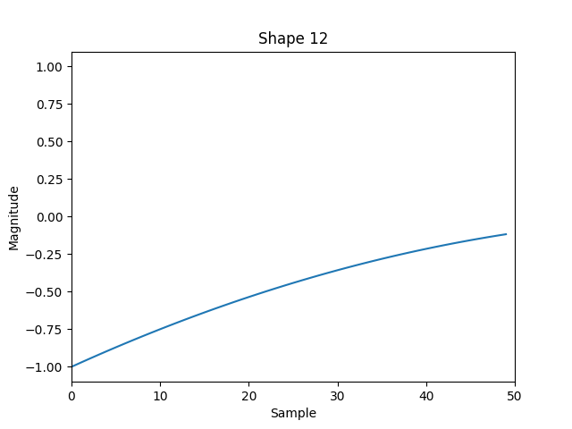
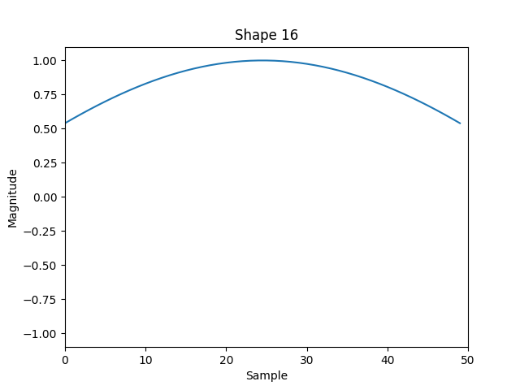
Approach 1: Searching Shapelets
Shapelet Definition
1. Introduction
2. Previous Work
3. Methods
4. Results
5. Discussion
6. Future Directions

Slide 23
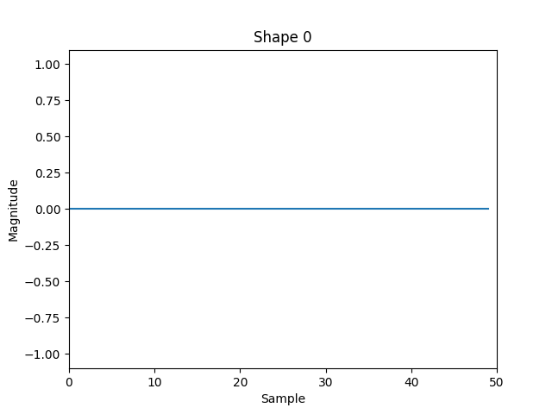
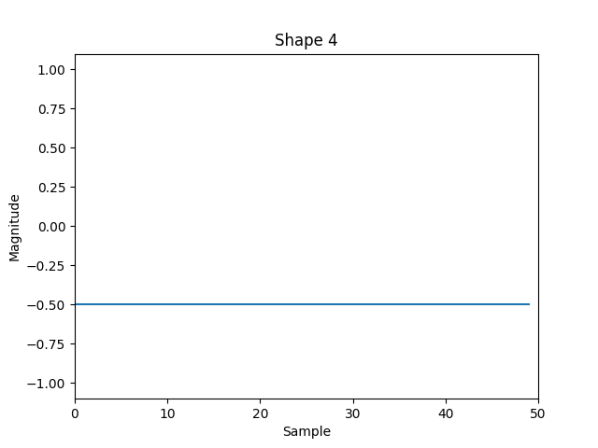
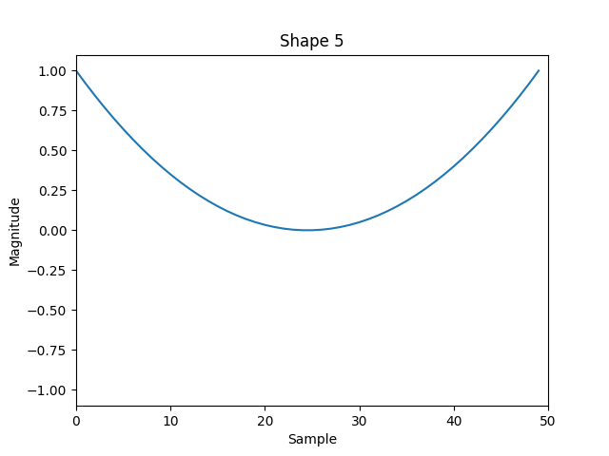
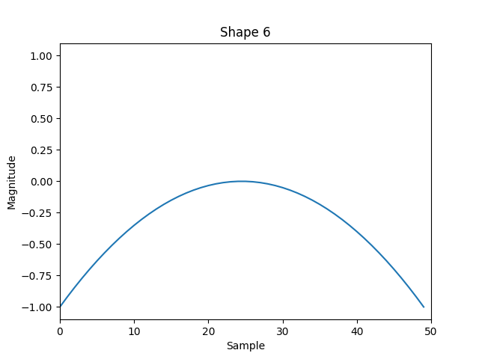
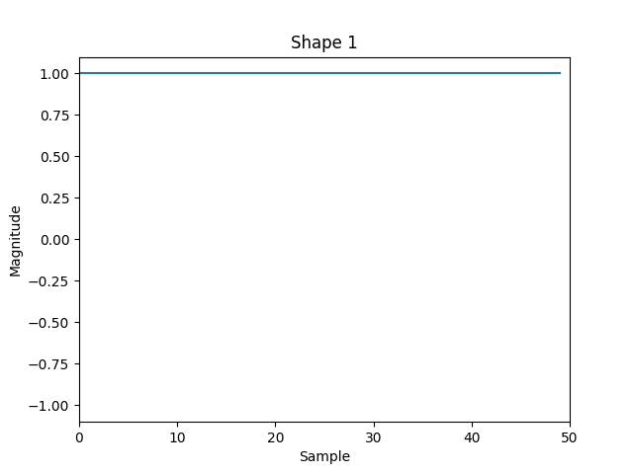
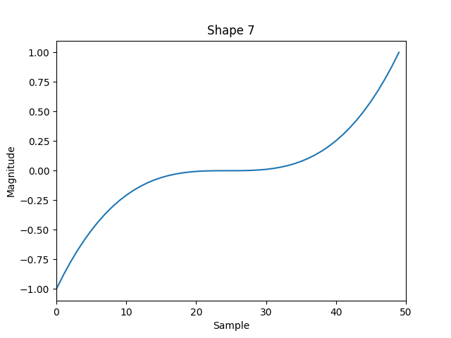
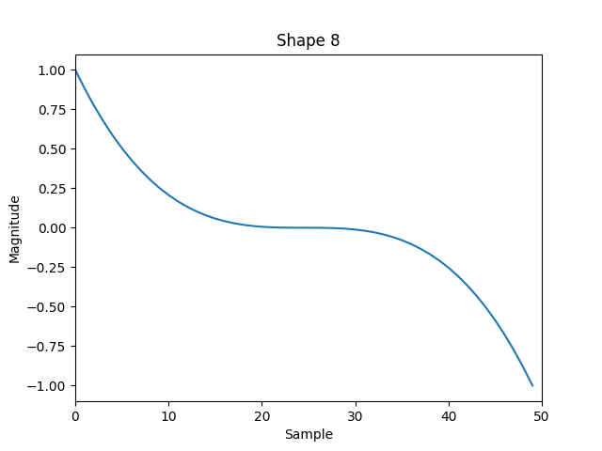
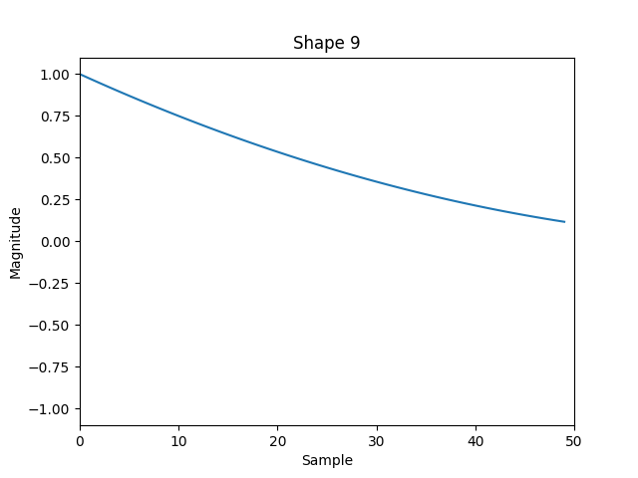
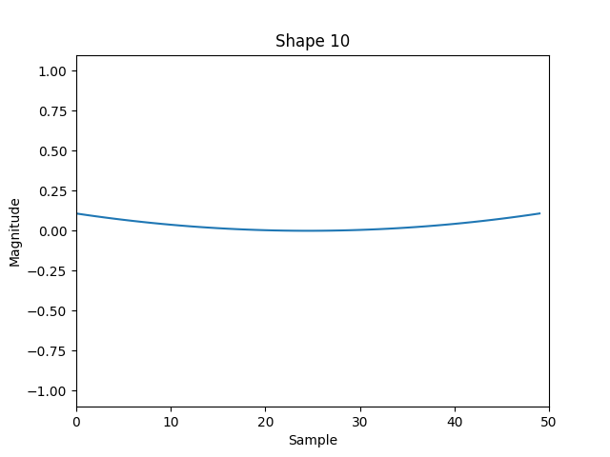
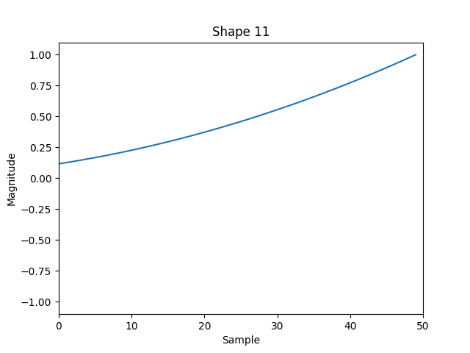
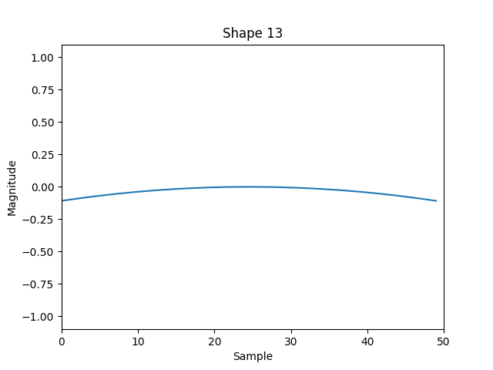
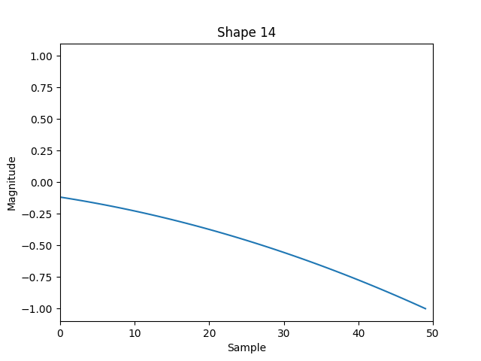
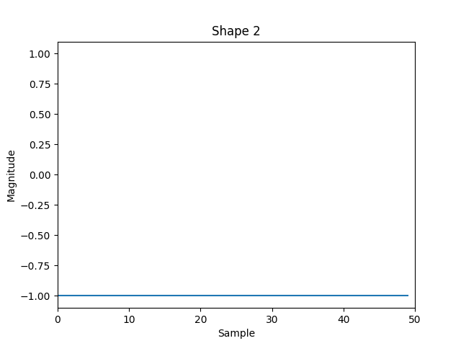
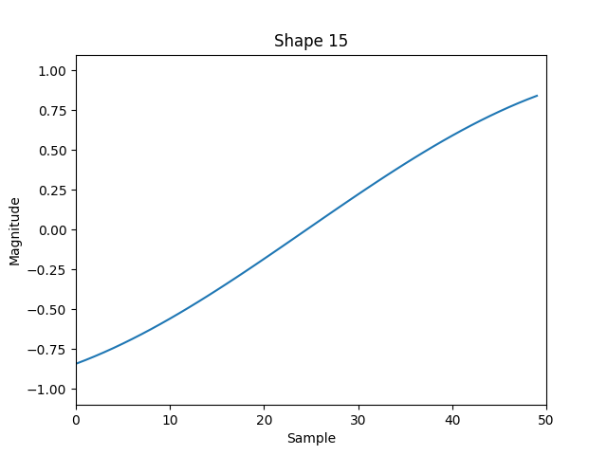
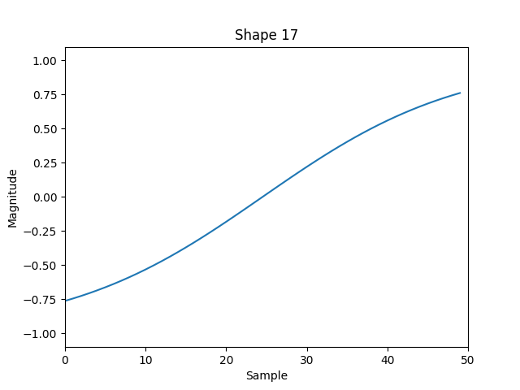
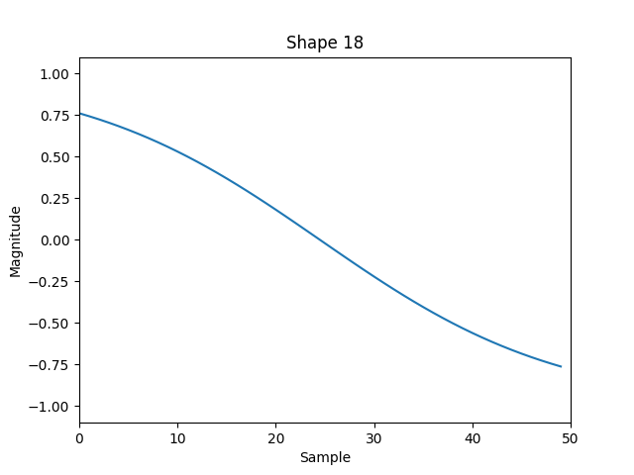
Approach 1: Searching Shapelets
Shapelet Definition
1. Introduction
2. Previous Work
3. Methods
4. Results
5. Discussion
6. Future Directions

Slide 24




Approach 1: Searching Shapelets
Shapelet Definition
1. Introduction
2. Previous Work
3. Methods
4. Results
5. Discussion
6. Future Directions

Slide 25

Approach 1: Searching Shapelets
Shapelet Definition
1. Introduction
2. Previous Work
3. Methods
4. Results
5. Discussion
6. Future Directions

Slide 26
Approach 1: Searching Shapelets
Feature Extraction (n=152)
1. Introduction
8 Datastreams
2. Previous Work
World Free Acc x
19 Shapelets
3. Methods
World Free Acc y
World Free Acc z
4. Results
Norm World Free Acc
Gyro x
5. Discussion
Gyro y
Gyro z
6. Future Directions
Norm Gyro

Slide 27
Approach 1: Searching Shapelets
Dimensionality Reduction I (n=38)
1. Introduction
2 Datastreams
2. Previous Work
World Free Acc x
19 Shapelets
3. Methods
World Free Acc y
World Free Acc z
4. Results
Norm World Free Acc
Gyro x
5. Discussion
Gyro y
Gyro z
6. Future Directions
Norm Gyro

Slide 28
Approach 1: Searching Shapelets
Dimensionality Reduction II (n ≤ 8)
1. Introduction
19 Shapelets
2 Datastreams
2. Previous Work
World Free Acc x
3. Methods
World Free Acc y
World Free Acc z
4. Results
Norm World Free Acc
Gyro x
5. Discussion
Gyro y
≤ 4 Shapelets
Gyro z
6. Future Directions
Norm Gyro

Slide 29
Approach 1: Searching Shapelets
Dimensionality Reduction II (n ≤ 8)
1. Introduction
19 Shapelets
2 Datastreams
2. Previous Work
World Free Acc x
3. Methods
World Free Acc y
World Free Acc z
4. Results
Norm World Free Acc
Recursive Feature Elimination
Gyro x
5. Discussion
Gyro y
Gyro z
6. Future Directions
≤ 4 Shapelets
Norm Gyro

Slide 30

Approach 1: Searching Shapelets
Dimensionality Reduction II (n ≤ 8)
1. Introduction
Recursive Feature Elimination
via SVM
2. Previous Work
Label: 1
Label: -1
3. Methods
$$\vec{w}$$
4. Results
Feature 2
5. Discussion
6. Future Directions
Feature 1

Slide 31






Approach 2: Learning Shapelets
[15]
1. Introduction
2. Previous Work
3. Methods
4. Results
5. Discussion
6. Future Directions

Slide 32

Approach 2: Learning Shapelets
[15]
1. Introduction
2. Previous Work
3. Methods
4. Results
5. Discussion
6. Future Directions

Slide 33
Evaluation
Event-based Assessment
1. Introduction
2. Previous Work
Movement
Ground Truth
3. Methods
Prediction
4. Results
5. Discussion
Rest
6. Future Directions
Flicker
t
-80 ms
+300 ms

Slide 34

Starting Point
1. Introduction
Window Size
* 25 Samples
2. Previous Work
3. Methods
4. Results
5. Discussion
6. Future Directions

Slide 35
Preprocessing (Data Stream Selection)
1. Introduction
Window Size
* 25 Samples
2. Previous Work
3. Methods
4. Results
5. Discussion
6. Future Directions

Slide 36
Preprocessing (Kalman Filter)
1. Introduction
Window Size
* 25 Samples
2. Previous Work
3. Methods
4. Results
5. Discussion
6. Future Directions

Slide 37
Window Size
1. Introduction
Window Size
* 25 Samples
FPR: 2.5%
FPR: 2.5%
2. Previous Work
x 50 Samples
3. Methods
FPR: 12.5%
FPR: 15%
4. Results
5. Discussion
6. Future Directions
X

Slide 38

Approach 1: Searching Shapelets
1. Introduction
v
2. Previous Work
3. Methods
4. Results
5. Discussion
6. Future Directions

Slide 39
Approach 1: Searching Shapelets
1. Introduction
v
2. Previous Work
3. Methods
4. Results
5. Discussion
6. Future Directions

Slide 40

Approach 1: Searching Shapelets
1. Introduction
v
2. Previous Work
3. Methods
4. Results
5. Discussion
6. Future Directions

Slide 41
Approach 1: Searching Shapelets
1. Introduction
v
2. Previous Work
3. Methods
4. Results
5. Discussion
6. Future Directions

Slide 42




Approach 1: Searching Shapelets
25 Samples
50 Samples
1. Introduction
2. Previous Work
Accelerometer
3. Methods
4. Results
5. Discussion
6. Future Directions
Gyroscope

Slide 43
Approach 1: Searching Shapelets
25 Samples
50 Samples
1. Introduction
2. Previous Work
Accelerometer
3. Methods
4. Results
5. Discussion
Gyroscope
6. Future Directions

Slide 44
Approach 1: Searching Shapelets
25 Samples
50 Samples
1. Introduction
2. Previous Work
Accelerometer
3. Methods
4. Results
5. Discussion
Gyroscope
6. Future Directions

Slide 45

Approach 1: Searching Shapelets
1. Introduction
Accelerometer
Gyroscope
2. Previous Work
3. Methods
4. Results
5. Discussion
6. Future Directions

Slide 46

Approach 2: Learning Shapelets
1. Introduction
Accelerometer
Gyroscope
2. Previous Work
3. Methods
4. Results
5. Discussion
6. Future Directions

Slide 47

Approach 2: Learning Shapelets
1. Introduction
2. Previous Work
3. Methods
4. Results
5. Discussion
6. Future Directions

Slide 48
Approach 2: Learning Shapelets
1. Introduction
2. Previous Work
3. Methods
4. Results
5. Discussion
6. Future Directions

Slide 49
Approach 2: Learning Shapelets
1. Introduction
2. Previous Work
3. Methods
4. Results
5. Discussion
6. Future Directions

Slide 50
Approach 2: Learning Shapelets
1. Introduction
FPR: 2.5%
2. Previous Work
3. Methods
4. Results
5. Discussion
6. Future Directions

Slide 51
Overview
1. Introduction
Pipeline
2. Previous Work
Preprocessing
Approaches
Fine-Tuning
3. Methods
1: Searching Shapelets
- Datastream Selection
Grid Search:
State-Machine
4. Results
2: Learning Shapelets
- Filtering
3: Targeted Logistic Regression
5. Discussion
6. Future Directions

Slide 52
Literature
V. L. Feigin, M. Brainin, B. Norrving, S. Martins, R. L. Sacco, W. Hacke, M. Fisher, J. Pandian, and P. Lindsay. World stroke organization (WSO): Global stroke fact sheet 2022. Int. J. Stroke, 17(1):18–29, 2022.
D. T. Wade, R. Langton-Hewer, V. A. Wood, C. E. Skilbeck, and H. M. Ismail. The hemiplegic arm after stroke: measurement and recovery. Journal of Neurology, Neurosurgery amp; Psychiatry, 46(6):521–524, 1983.
S. C. Cramer, G. Nelles, R. R. Benson, J. D. Kaplan, R. A. Parker, K. K. Kwong, D. N. Kennedy, S. P. Finklestein, and B. R. Rosen. A functional mri study of subjects recovered from hemiparetic stroke. Stroke, 28(12):2518–2527, 1997.
V. M. Parker, D. T. Wade, and R. Langton Hewer. Loss of arm function after stroke: measurement, frequency, and recovery. International Rehabilitation Medicine, 8(2):69–73, 1986.
H. Nakayama, H. S. Jørgensen, H. O. Raaschou, and T. S. Olsen. Recovery of upper extremity function in stroke patients: The copenhagen stroke study. Archives of Physical Medicine and Rehabilitation, 75(4):394–398, 1994.
E. S. Lawrence, C. Coshall, R. Dundas, J. Stewart, A. G. Rudd, R. Howard, and C. D. A. Wolfe. Estimates of the prevalence of acute stroke impairments and disability in a multiethnic population. Stroke, 32(6):1279–1284, 2001.
A. Pollock, B. St George, M. Fenton, and L. Firkins. Top ten research priorities relating to life after stroke. The Lancet Neurology, 11(3):209, 2012.
S. Anwer, A. Waris, S. O. Gilani, J. Iqbal, N. Shaikh, A. N. Pujari, and I. K. Niazi. Rehabilitation of upper limb motor impairment in stroke: A narrative review on the prevalence, risk factors, and economic statistics of stroke and state of the art therapies. Healthcare, 10(2):190, 2022.
R. J. Nudo and K. M. Friel. Cortical plasticity after stroke: implications for rehabilitation. Rev. Neurol. (Paris), 155(9):713–717, 1999.

Slide 53
Literature
H. Duffau. Brain plasticity: From pathophysiological mechanisms to therapeutic applications. Journal of Clinical Neuroscience, 13(9):885–897, 2006.
F. E. Buma, E. Lindeman, N. F. Ramsey, and G. Kwakkel. Review: Functional neuroimaging studies of early upper limb recovery after stroke: A systematic review of the literature. Neurore-habilitation and Neural Repair, 24(7):589–608, 201
N. D. Engineer, T. J. Kimberley, C. N. Prudente, J. Dawson, W. B. Tarver, and S. A. Hays. Targeted vagus nerve stimulation for rehabilitation after stroke. Frontiers in Neuroscience, 13, 2019.
N. D. Engineer, J. R. Riley, J. D. Seale, W. A. Vrana, J. A. Shetake, S. P. Sudanagunta, M. S. Borland, and M. P. Kilgard. Reversing pathological neural activity using targeted plasticity. Nature, 470(7332):101–104, 2011.
K. He, M. Huertas, S. Z. Hong, X. Tie, J. W. Hell, H. Shouval, and A. Kirkwood. Distinct eligibility traces for ltp and ltd in cortical synapses. Neuron, 88(3):528–538, 2015.
Grabocka, N. Schilling, M Wistuba, and L. Schmidt-Thieme. Learning time-series shapelets. In Proceedings of the 20th ACM SIGKDD international conference on Knowledge discovery and data mining, KDD ’14. ACM, 2014.
G. Li, B. Choi, J. Xu, B. S. Bhowmick, K.-P. Chun, and L.-H. Wong, G. Efficient shapelet discovery for time series classification. IEEE Transactions on Knowledge and Data Engineering, 34(3):1149–1163, 2022.

Slide 54
Evaluation
Event-based Assessment
1. Introduction
2. Previous Work
Movement
Ground Truth
3. Methods
Prediction
4. Results
5. Discussion
Rest
6. Future Directions
Flicker
t
-80 ms
+300 ms

